Slide 1
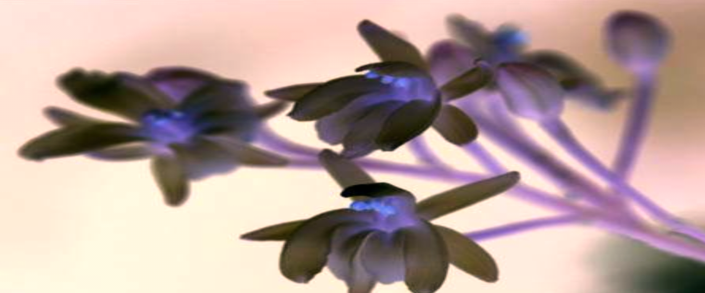
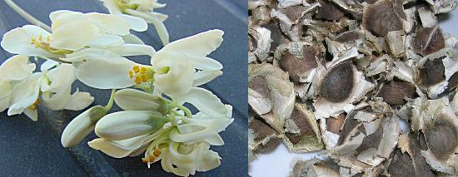
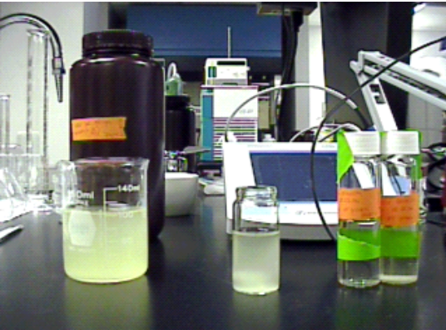
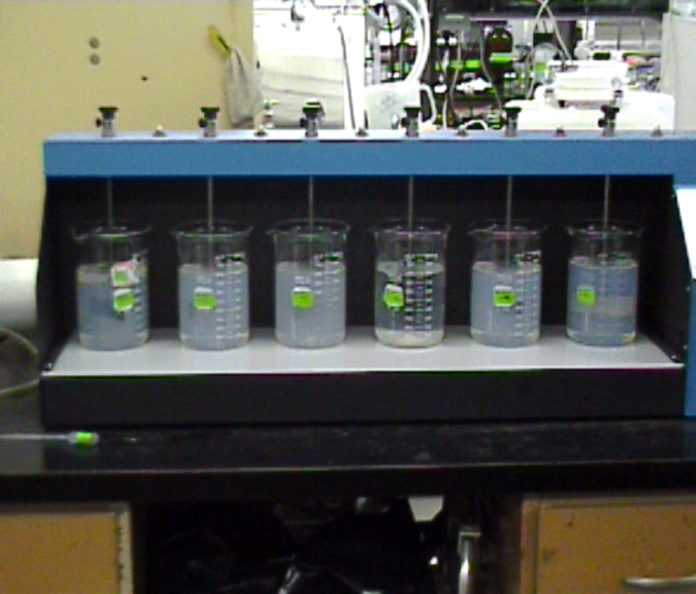
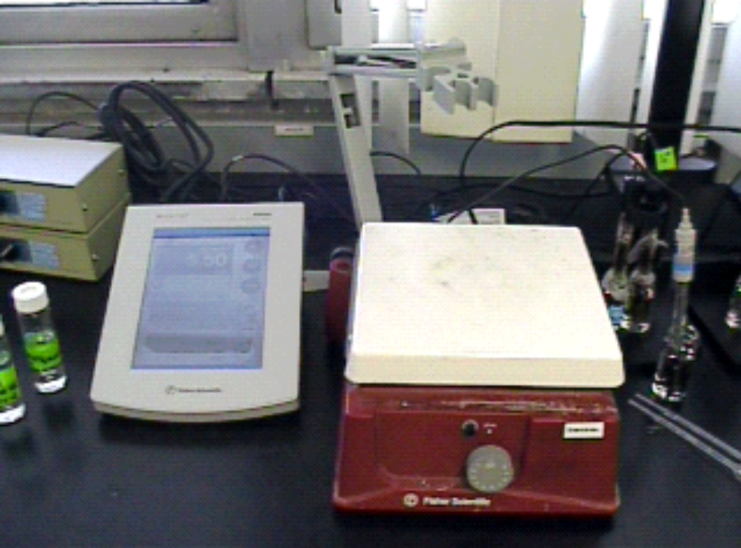
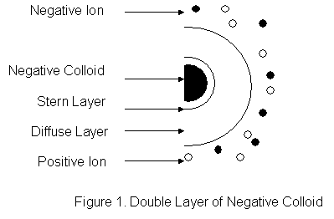
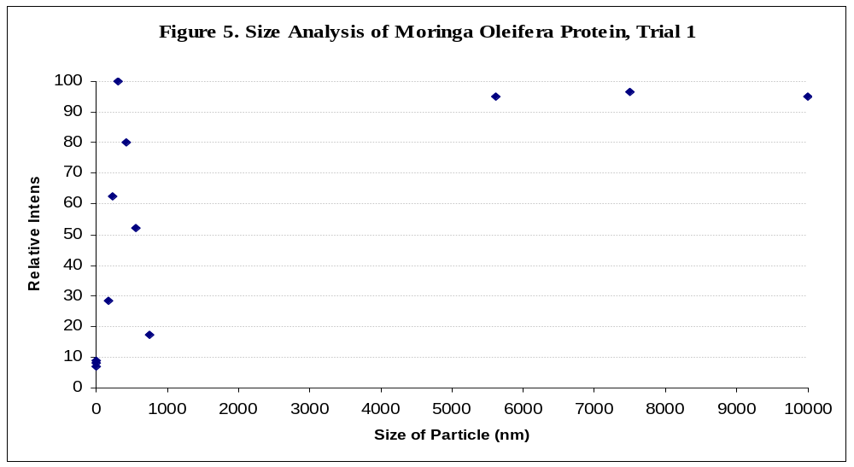
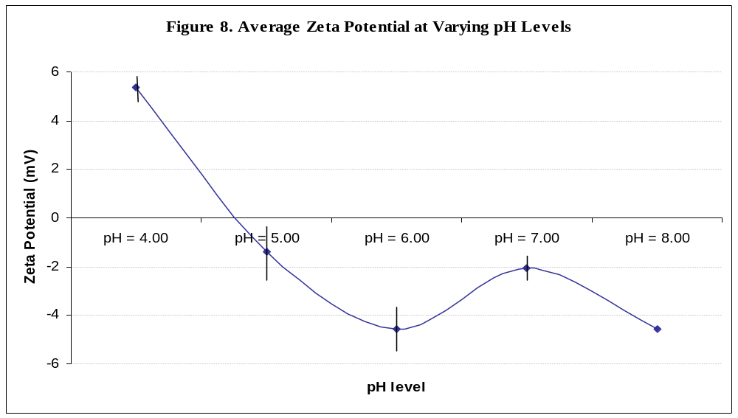
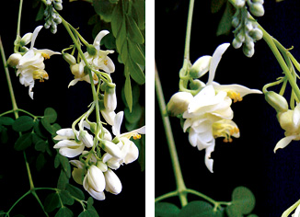
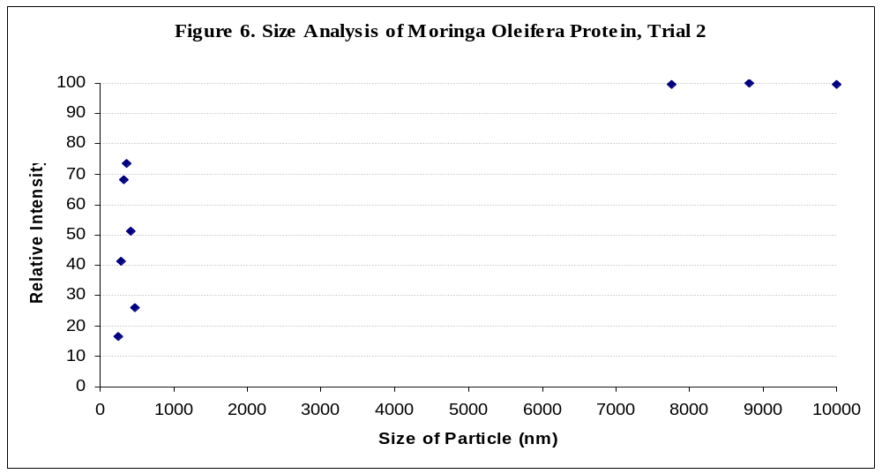
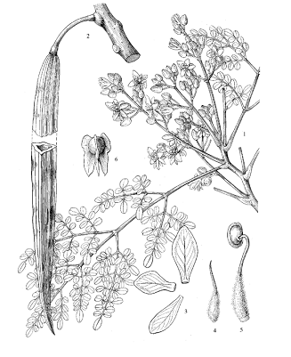
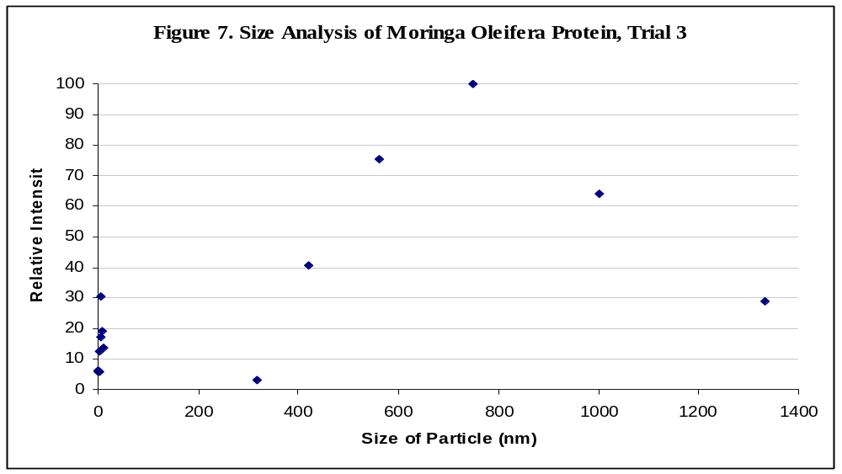
Statement of Problem
Moringa Oleifera: Elucidation of Physicochemical Properties of the Active Protein and Optimization of Water Purification
Results
What physicochemical properties, such as size and zeta potential, of the active protein in Moringa Oleifera account for the ability of the Moringa Oleifera seeds to perform as primary coagulants in water purification? How do these physiochemical properties change as the acidity of the environmental solution increases or as the alkalinity increases?
By characterizing the properties of the active protein, what are the optimum environmental conditions for using Moringa Oleifera seeds as primary coagulants in water purification?
The characterization of the size of the Moringa Oleifera protein showed a representative analysis of the size of the protein (Figures 3, 4, 5). Generally, each trial of particle sizing produced two or three size fractions, groups of sizes detected within the protein dispersion. Though size fractions above 1000nm were obtained, this is not likely to represent the size of the proteins. Since the protein permeate was filtered through a 1-micron and then a 0.45-micron membrane, the protein should be, theoretically, smaller than 450nm. This theory is substantiated through the other two visible size fractions from the analysis. Since coagulation studies yielded large visible flocs, the theory that the protein particles are larger is also substantiated. As a result, the size fraction that wavers between 100nm and 450nm represents the particle size analysis of the Moringa Oleifera protein.
The characterization of zeta potential of the Moringa Oleifera protein presented an approximation of the optimum pH conditions for optimum water coagulation. In Figure 6, the graph of the pH level versus the zeta potential crosses the pH x-axis at approximately 4.00. This means that the energy barrier is completely dissipated (zeta potential equals 0) at pH = 4.00; thus colloids and Moringa Oleifera proteins coagulate easily. However, there was a sudden increase in zeta potential at neutral pH, when the general trend was decreasing zeta potential. This phenomena is later corresponded by the results of Coagulation Study 3.
In Coagulation Study 1, the effects of dosage of Moringa Oleifera and the effects of pH on the lake water were determined. Though, theoretically, high dosages of coagulants would supply more proteins to counteract colloids in the lake water, the medium dosage proved to be the most effective. Excess protein molecules from the high dosages of Moringa Oleifera may have contributed to the larger value of turbidity. Significant decreases in turbidity were recorded: original turbidity of 6.37 NTU decreasing 79.6% to 1.30 NTU. With the World Health Organization hygienic turbidity level at 1 NTU, this reduction in turbidity of the lake water is extremely significant.
In Coagulation Study 2, the effects of dosage of Moringa Oleifera and the effects of pH on synthetic waters made with silica particles were determined. The most significant value of the Coagulation Study 2 was the effect of the 1.0 gram of Moringa Oleifera. Whereas the original turbidity of the silica solution was 72.7 NTU, the addition of 1.0 gram of Moringa Oleifera drastically decreased the turbidity to 16.1 NTU. In this jar, the silica particles and the protein particles formed visible flocs unlike other jars which maintained a milky hue (see below). This not only substantiates the assertion that Moringa Oleifera is an efficient primary water coagulant, but also supports the assumption that protein particles are large, thus forming visible flocs.
In Coagulation Study 3, the effects of pH on constant Moringa Oleifera dosages were determined. As pH increased from a range of 6 to 9, the turbidity value experienced a trend similar to the trend of the zeta potential graph of the Moringa Oleifera proteins. As the pH increased from 6.05 to 7.77 the turbidity generally decreased, However, as the pH increased from 7.77 to 9.03, the turbidity began to increase. This phenomena corresponds to the sudden increase in zeta potential at neutral pH in Figure 6. Coincidentally, the results from Coagulation Study 3 also parallel this phenomena with lowest turbidity at neutral pH.
Introduction
Widely cultivated in Africa, Central America, India, Mexico, and the Philippines, Moringa Oleifera is also known as the “Drumstick Tree” and is the most widely cultivated of the genus Moringa for its abundant benefits. Moringa Oleifera, a subtropical and tropical plant of the Moringaceae family, is a natural coagulant, a substance that agglomerates with colloid particles in water to purify turbid water. Whereas the chemical coagulants are moderately costly and efficient, the seeds of Moringa Oleifera provide a cheap and efficient method of environmentally friendly water purification.
The seeds of the Moringa Oleifera have become an area of interest among environmental scientists as the source of abilities for water coagulation. When the seeds are husked and macerated, the resultant substance is placed in turbid water. After stimulating coagulation by stirring or shaking the solution, the colloids and the seeds form visible flocs that settle to the bottom. Some scientists have isolated an active antimicrobial agent in the Moringa Oleifera seeds: 4α L-rhamnosyloxy-benzyl isothiocyanate. Several scientists have determined that an active cationic protein in the seed explains the agglomeration of the Moringa Oleifera seeds and the negatively charged particulates in the raw waters.
In order to fully comprehend the behavior of the protein, this investigation focuses on analyzing the size of this active protein and the change in zeta potential of the protein as the pH level fluctuates. An average protein size would range from 5 to 400 micrometers. Small proteins would not conglomerate with negative colloids to form large, visible flocs. On the other hand, larger proteins would form flocs in the water when the proteins and the colloids combine. Thus, size should play a major role in the characterization of the active protein.
Another important physicochemical aspect of the Moringa Oleifera protein is the zeta potential, the electrostatic potential generated by the ions at the surface of a particle with an electrical double layer (Figure 1). As positive ions accumulate around the negative colloid, the Stern Layer, tight accumulation of positive ions, and the Diffuse Layer, loose association of positive ions, form. However, an equilibrium is reached as the positive ions counteract the charge of the negative colloid, causing excess negative ions and colloids to remain in the solution. Coagulants, such as the Moringa Oleifera, lower the energy barrier, or the surface charge, and the two particles, colloid and coagulant, agglomerate forming flocs.
Methods and Materials
Extraction of Protein
Analysis of Zeta Potential
Coagulation Studies
Dry seeds were husked with a knife to obtain the center of the seed, which contains the protein.
Approximately 25.00 grams of the husked seeds were macerated with a mortar and pestle in 250 mL of deionized water to obtain an approximate concentration of 1 gram of macerated seeds per 10 mL of deionized water.
The seed dispersion was set on a stir plate at 300 revolutions per minute for 45 minutes, advocating the release of the proteins from the seeds.
Four filtration units were set up. Each filtration unit consisted of a 200 mL beaker with a funnel and a 1-micron filter placed in the funnel. The seed dispersion was split between the 4 filtration units until the liquid drained into the beakers.
Using a Solvent-Resistant Stirred Cell by Amicon, the liquid was filtered again through a 0.45-micron membrane under 40 psi (pounds per square inch) of pressure into a beaker.
First, the original conductivity and pH level of the solution were measured with the pH electrode.
5 different solutions were prepared for zeta potential testing: pH = 4.00, 5.00, 6.00, 7.00, and 8.00.
With the solution at pH =4.00, three cuvettes were filled with the solution of pH= 4.00. The temperature and number of runs on ZetaPALS were set to 25 degrees Celsius and 10 runs.
Each solution was run through the ZetaPALS instrument once to get a total of three measurements of zeta potential for the pH of 4.00.
The same procedure for zeta potential was repeated for solutions at pH = 5.00, 6.00, 7.00, and 8.00.
To simulate the large-scale water coagulation (Figure 2), the coagulant, Moringa Oleifera, was added to the lake water and then introduced into a Phillips and Byrd Jar Tester. Coagulation was promoted through rapid mixing at 100rpm. Flocculation was promoted through slow mixing at 20rpm, supplying the colloids and the proteins with sufficient kinetic energy to overcome the energy barrier. Sedimentation was imitated by allowing the waters to be undisturbed for 1 hour. Filtration of the waters after sedimentation occurred using a 1-micron membrane.
Prior to and after all coagulation studies, pH, turbidity, color, and conductivity were measured with the pH electrode for an initial and final reading.
For each of the three coagulation studies, 6 jars were used, each with a different mixture of components (Table 1).
Increasing the acidity of the solution or seed dispersion was achieved with a diluted hydrochloric acid solution with pH level of 1.07. All increases in alkalinity were achieved with a diluted sodium hydroxide solution with pH level of 12.59.
Moringa Oleifera Flower and Seeds
Taken by DeLange
Table 1. Clarification of Coagulation Study Components
Coagulation Study 2. Silica Particles
Starting from left:
Jar 1: Silica Solution
Jar 2: Silica Solution, 0.01 gram seed dispersion
Jar 3: Silica Solution, 0.10 gram seed dispersion
Jar 4: Silica Solution, 1.00 gram seed dispersion
Jar 5: Silica Solution, pH = 5.80
Jar 6: Silica Solution, pH = 8.85
Taken by Joyce Chai
Seed Dispersion after Isolation of Protein
Taken by Joyce Chai
Study #
Jar 1
Jar 2
Jar 3
Jar 4
Jar 5
Jar 6
1
Lake water
Lake water 0.01 g seed
Lake water 0.10 g seed
Lake water 1.0 g seed
Lake water
pH=6
Lake water pH=9
pH Electrode and Conductivity Meter
Taken by Joyce Chai
Analysis of Protein and Silica Size
For the Moringa Oleifera proteins, the solution filtered from the Stir Cell was diluted with 100-mL of deionized water.
Using a pipette, a cuvette for Particle Size Analysis on the Particle Sizing program by Brookhavens Instruments was filled with the diluted solution. The cuvette was placed in the instrument and the temperature was set to 25 degrees Celsius. A total of 10 runs was indicated on the program.
Two more samples were taken of the protein sample and were run through the Particle Sizing in order to get a total of three trials. The silica particles were also analyzed for size, however, 0.5 mL of the silica particles (SiO₂) was diluted in 1000-mL of deionized water in order to obtain the
sample for the size analysis.
2
Silica solution
Silica solution0.01 g seed
Silica solution 0.10 g seed
Silica solution1.0 g seed
Silica solution pH=5.80
Silica solution pH=8.8
3
Lake water 0.50 g seed pH=7.7
Lake water 0.50 g seed,pH=7.3
Lake water,
0.50 g seed
pH=6.0
Lake water
0.50 g seed pH=7.0
Lake water 0.50 g seed
pH=8.08
Lake water
0.50 g seed pH=9.0
(1)
Pre-settlement of
turbid waters
Hydraulic flocculation
Sedimentation
Filtration and Disinfection
(2)
Addition of Coagulant
Conclusions
Pre-settlement of
turbid waters
Flocculation (slow mixing)
Sedimentation- no disturbance
Filtration
(1-micron)
In this study of the Moringa Oleifera seed, the active protein in coagulation was extracted and characterized for size and zeta potential. The optimum conditions that were predetermined by the zeta potential were tested during the three coagulation studies.The effectiveness of the Moringa Oleifera seeds as a primary water coagulant was substantiated. Certain optimum conditions were derived from the three coagulation studies.
The representative analysis of the size of the Moringa Oleifera protein yielded sizes between 100nm and 400nm. Larger particles that were detected may have been dust particles or even the results of the aggregation of the protein in the Moringa Oleifera seed. The original hypothesis of a relatively large active protein was substantiated.
Zeta potential analyses concluded that optimum conditions would occur at a pH of 4.00, the pH where the zeta potential is zero, thus creating a small energy barrier to overcome. This rejected the original theory that the zeta potential would be zero around a neutral pH.
Though the zeta potential analyses rejected the theory that zeta potential would be zero around a neutral pH, the coagulation studies substantiated the theory that optimum conditions for Moringa Oleifera usage would be at neutral pH. Indeed, turbidity significantly decreased at the neutral pH during Coagulation Study 3. Optimum dosages of the Moringa Oleifera seed solely depended upon the amount of colloids present in the waters being tested.
Among other conclusions, this investigation contributed to the firm establishment that Moringa Oleifera is an effective and environmentally friendly water coagulant.
Figure 2. Sequence of Steps for Water Coagulation
(1) Conventional Coagulation Treatments
(2) Water Coagulation for Moringa Oleifera seeds
Hypothesis
Data
After isolating the active protein from the seed, size analysis of the active protein should reveal a relatively large size. A larger size corresponds with increased kinetic energy and increased surface charge, thus allowing particles to coagulate easily and overcome the energy barrier. The larger size, as previously mentioned, also contributes to the development of large flocs when the negative colloids and the cationic proteins conglomerate.
Zeta potential analyses at varying pH levels should be different, thus coagulant ability should be different. Furthermore, zeta potential should decrease as pH level increases, or becomes more basic. Thus, the value of zeta potential should be zero around neutral pH.
Optimum conditions of water coagulation with Moringa Oleifera should occur at neutral pH, the estimated pH when zeta potential is zero thus the energy barrier would be easily overcome.
The optimum dosage of Moringa Oleifera that should be used in the water coagulation simulations should be relative to the colloid number and the turbidity of the water.
Figure 3. Size Analysis of Moringa Oleifera Protein, Trial 1
Figure 6. Average Zeta Potential at Varying pH Levels
Jar
Turbidity
(NTU)
Table 3. Coagulation Study 2 Data
1
68.3
Residual Turbidity
Color (CU)
Residual Color
pH
Conductivity (μS/cm)
2
77.5
-4.4
>99999
0
6.43
5.98
3
89.1
+4.8
>99999
0
6.53
6.24
4
16.1
+16.4
>99999
0
6.38
10.8
5
72.2
-56.6
343
-99656
6.25
44.7
Moringa Oleifera Flower
Taken by Syfia International
Figure 4. Size Analysis of Moringa Oleifera Protein, Trial 2
6
63.4
-0.5
>99999
0
6.43
11.2
Silica
Water
72.7
-9.3
>99999
0
8.50
74.1
Anatomy of Moringa Oleifera
-----
>99999
-----
6.79
5.47
Jar
Turbidity
(NTU)
Table 2. Coagulation Study 1 Data
Table 4. Coagulation Study 3 Data
1
6.38
Residual Turbidity
Color (CU)
Residual Color
pH
Conductivity (mS/cm or μS/cm)
Jar
Turbidity
(NTU)
Residual Turbidity
Color (CU)
Residual Color
pH
Conductivity (mS/cm)
2
3.17
+0.01
389
+3
8.07
1.15 mS/cm
1
1.05
-5.32
275
111
7.55
1.17
Figure 5. Size Analysis of Moringa Oleifera Protein, Trial 3
3
1.30
-3.20
307
-79
7.77
969 μS/cm
2
2.00
-4.37
280
106
7.62
1.22
Further Research
4
3.33
-5.07
282
-104
8.07
958 μS/cm
3
3.13
-3.24
293
93
6.82
1.31
5
2.08
-3.04
292
-94
7.70
969 μS/cm
4
1.41
-4.96
272
114
7.57
1.23
Further research may include investigating the observed phenomena at neutral pH. Other investigations may include developing nanoparticles that may complement the water coagulation of Moringa Oleifera to produce a highly effective and efficient water purification unit. The same procedures may be repeated; however, instead of using regular Moringa Oleifera seeds, seeds with extracted oil will be used. In the future, the Moringa Oleifera water coagulation technique may also be applied to large-scale applications.
6
1.39
-4.29
309
-77
7.87
1.22 mS/cm
5
2.55
-3.82
288
98
7.84
1.20
Lake
Water
6.37
-4.98
296
-90
8.91
1.20 mS/cm
6
2.17
-4.20
280
106
8.76
1.25
Drawn by EFloras
-----
386
-----
8.08
1.05 mS/cm
Lake
Water
6.37
-----
386
-----
8.08
1.05

